Slide 1

Fundamentals of Energy Efficient Building Operations
Part 2: HVAC Fundamentals
Month Day, Year Instructor Name, Position
Instructor Company
Phone Name@email.com
Notes:
Instructor’s name: __________________________________________________________
Phone number: ____________________________________________________________
E-mail: ___________________________________________________________________
_________________________________________________________________________
_________________________________________________________________________
_________________________________________________________________________
_________________________________________________________________________

Slide 2
Part 2 Agenda
A. Introduction to HVAC
Heating & Cooling Systems
Air Systems
D. Learning activity: Mechanical Room Components

Slide 3
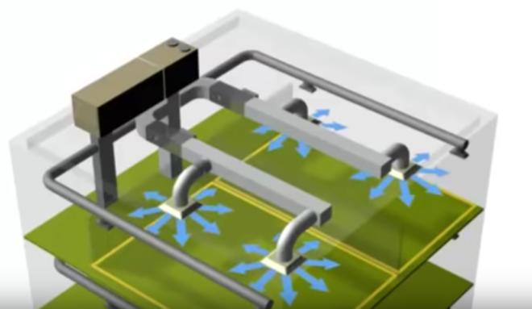
HVAC Systems Overview
https://youtu.be/ScVBPAitibQ?si=3gHp7BpiqS7OtDWq
Notes:
You can view this video that gives an overview of HVAC at the following link:
https://youtu.be/ScVBPAitibQ?si=3gHp7BpiqS7OtDWq
Or, you can search “HVAC Training – Basics of HVAC” from Price Industries on YouTube.
NOTE: This video may feel dated, but the information is relevant and useful. It is provided by one of many HVAC equipment suppliers. Please note that the BOC Program does not intend to endorse or promote any specific equipment brands or suppliers.

Slide 4
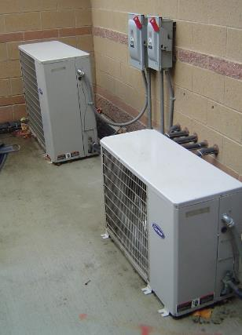
HVAC Systems: Basics
Functions of HVAC:
Heating
Air ventilation
Cooling
Air filtration
Humidification and de-humidification
Protect critical building infrastructure
Fire and life safety
Notes:
Collectively, heating, ventilation, and cooling (HVAC) equipment and systems are designed to control the indoor environment.
HVAC systems consume significant amounts of energy and are not necessarily designed with energy efficiency in mind.
Good design includes the following critical missions of the HVAC system in a building:
Provide comfortable conditions for people working inside the building.
Remove indoor contaminants and replace with fresh outdoor air.
Protect critical building infrastructure (for example, provide protection against high temperatures for computers and protection against frost/freeze for pipes transporting water).
Regulate the humidity to mitigate mold growth.
Contribute to fire and life safety. For example, HVAC systems that are integrated with a fire alarm system can help compartmentalize a building in case of fire by controlling ventilation to prevent fire spread or for smoke control. And in extreme weather events, HVAC systems can help buildings serve as warming or cooling stations.

Slide 5
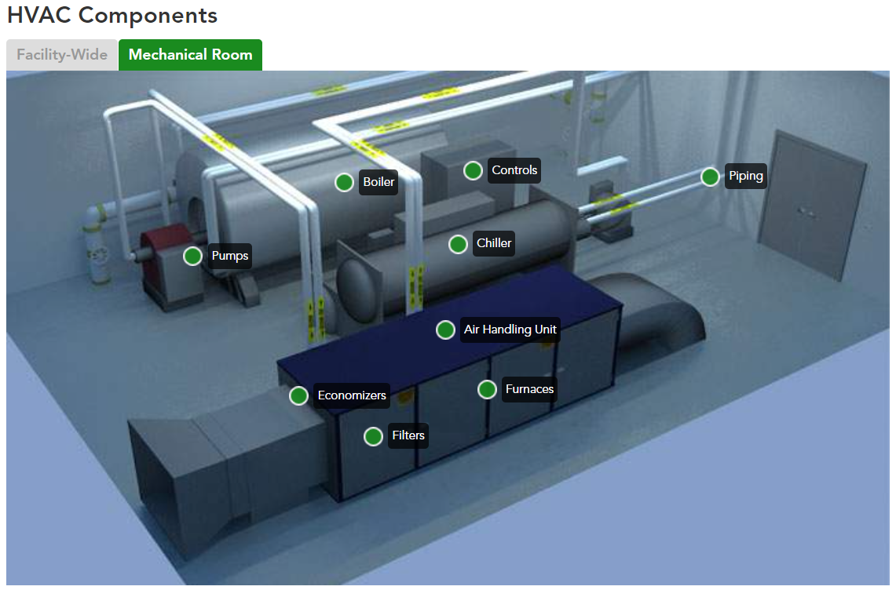
Mechanical Room
https://sftool.gov
Notes:
This image shows a hypothetical example of a mechanical room containing common HVAC equipment. In many buildings, this equipment would be spread out in different parts of the building rather than located in one room.
More detail on each of these components can be found by clicking the labels at the following link:
https://sftool.gov/explore/green-building/section/9/hvac/system-overview#mechanical-room
The Sustainable Facilities Tool, provided by the U.S. General Services Administration, includes a virtual building that you can explore to learn more about various aspects of building systems.
https://sftool.gov/explore

Slide 6
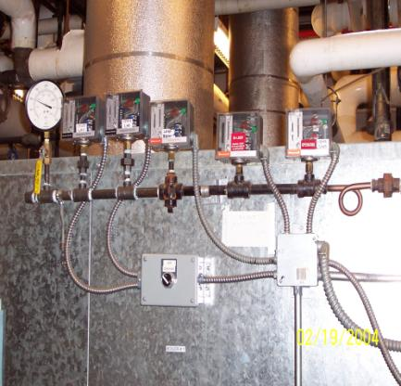
Boiler Fundamentals
Steam
Hot Water
Non-condensing
Condensing
Alternatives?
Courtesy TBS
Notes:
Boilers make steam or hot water for heating buildings, with varying efficiency.
The lower the heating water temperature can be set and effectively used in any building, the better the opportunity for savings.
Many boilers burn fossil fuels (typically natural gas or oil) to generate heat, but electric boilers are also available. In many regions, heat pumps (which run on electricity and are very efficient) are being implemented as an alternative to fossil fuel-based boilers. We’ll explore heat pumps in more detail later in this class.
(Refer to ASHRAE Systems and Equipment for more information.)

Slide 7
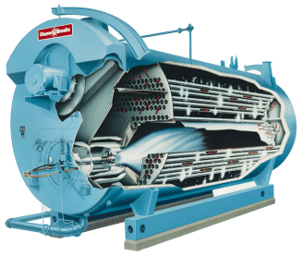
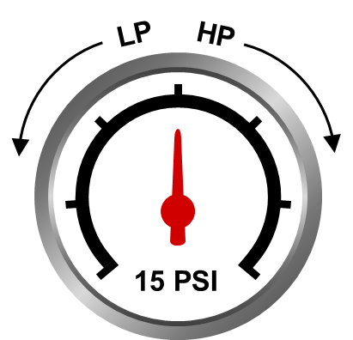
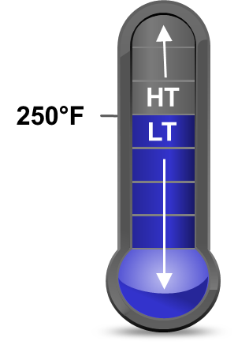
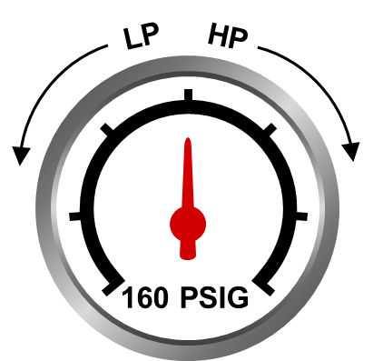
Boiler Types
Fire tube and water tube
High mass – stand by
Modular – instantaneous
Steam:
Low pressure
High pressure
Hot water:
LT/LP Low Temperature/Low Pressure
HT/HP High temperature/High Pressure
Courtesy: Cleaver Brooks
Notes:
Fire Tube and Water Tube boilers: Both boiler types use a shell and tube heat exchanger design. In a fire tube boiler the flame and products of combustion are routed through the tubes that exchange heat with water surrounding the tubes. In a water tube boiler this is reversed, water is routed through tubes surrounded by the flame and products of combustion.
High mass boiler: High mass are typically large conventional boilers that are slow to fire up and get functional and hot. These boilers are kept hot and have higher stand-by losses.
Modular boilers: Multiple units, typically low mass, quick to heat up water, with a focus on condensing units. These boilers are shut off between calls for heating and have lower off-cycle heat losses.

Slide 8
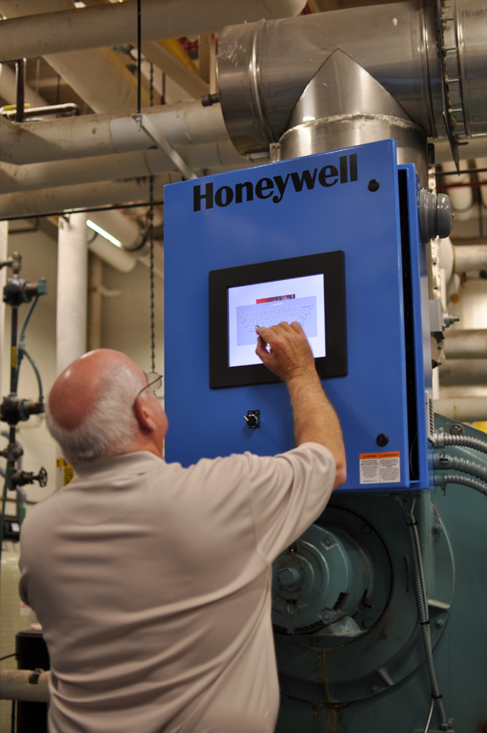
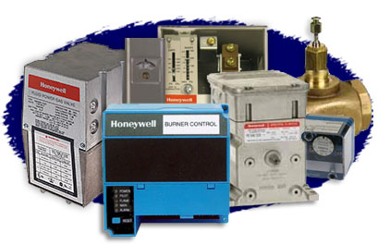
Steam Boilers
Dynamic pressures
Maintenance:
Water level floats
Boiler trim
Blowdown frequency
Feedwater system
Courtesy Honeywell
Notes:
The characteristics of boiler operation will vary at each building, depending on the way the controls are hooked up or installed via the building automation system (if one is used).
Dynamic pressure swings occur if there are excessive loads, cold water return or returned steam.
Water level floats are very critical and should be inspected daily.
The feedwater system includes the deaerator, water supply and a water treatment system.
To ensure the boiler is operating at its optimum level, check boiler trim, monitor blowdown frequency, firing rate, and water treatment program procedures. Note if any of these have changed or drifted from design conditions and past performance.

Slide 9
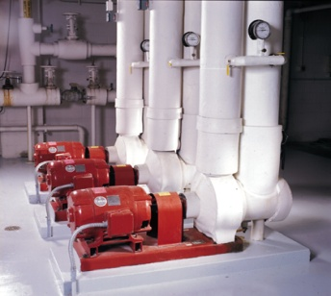
Hot Water Boilers
Control by water temperature (boiler reset)
Circulator pumps and burner interlocks
Different trim conditions
Air removal methods
Expansion tank
Courtesy TBS
Notes:
Hot water boilers make hot water at varying temperatures.
In general, energy codes requires a boiler reset control to adjust the boiler water temperature according to a corresponding outdoor air temperature to improve operating efficiency. In larger complex commercial facilities, more energy can be saved by keeping the boiler water constant and using variable speed pumping to reduce operating costs. The energy code allows the use of either method, based on which saves more energy.
Pumps, air removal methods, and expansion tanks are also critical components that need maintenance.

Slide 10
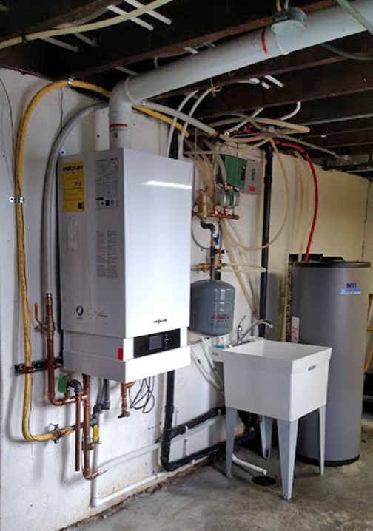
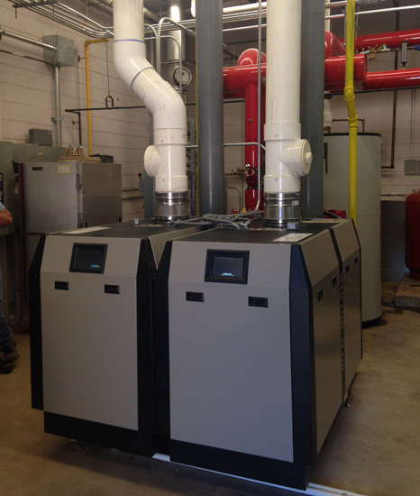
Condensing Boilers
Increase efficiency
Require condensate drainage system
Notes:
A Condensing Boiler extracts additional heat from the waste gases by condensing this water vapor to liquid water, thus recovering its latent heat of vaporization. A typical increase of efficiency can be as much as 10-12%. While the effectiveness of the condensing process varies depending on the temperature of the water returning to the boiler, it is always at least as efficient as a non-condensing boiler.
The condensate produced is slightly acidic (3-5 pH), so suitable materials must be used in areas where liquid is present. Aluminum alloys and stainless steel are most commonly used at high temperatures. In low temperature areas, plastics are most cost effective (e.g., uPVC and polypropylene). The production of condensate also requires the installation of a heat exchanger condensate drainage system. In a typical installation, this is the only difference between a condensing and non-condensing boiler.

Slide 11
Boiler Operation
98
96
Dew Point
94
92
90
Steady state boiler efficiency %
88
86
Non-Condensing
mode
Condensing
mode
84
82
80
60
80
100
120
140
160
180
200
Courtesy ASHRAE
Boiler return water temp ºF
Notes:
This chart, courtesy of ASHRAE, illustrates the principle of operating a condensing boiler at the lowest possible supply temperature to gain the maximum efficiency.
It is important to note that non-condensing boilers should not be run with return water temperatures that lead to condensation, or damage will likely occur.

Slide 12
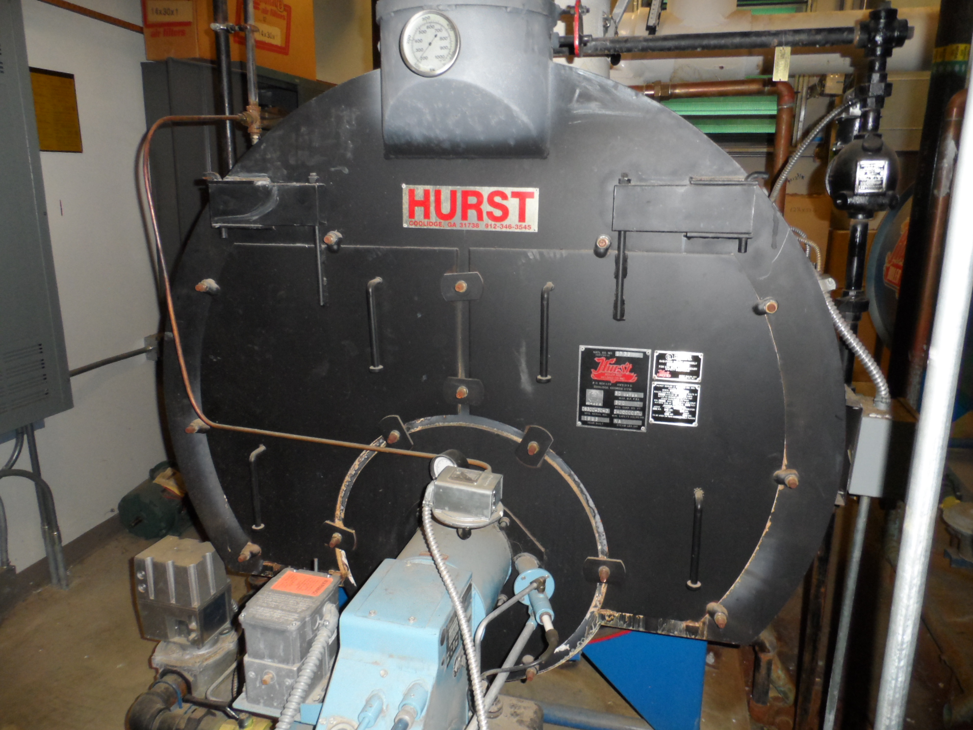
Boiler Maintenance
Includes:
Regular inspections
Record keeping
Accurate water treatment
Antifreeze maintenance (if applicable)
Blowdown daily? Or weekly?
Clean heat exchanging surfaces
Clean burners
Preventive maintenance
Notes:
Regular inspections in conjunction with accurate recordkeeping are crucial to an effective boiler maintenance program.
Accurate water treatment requires sophisticated analysis of make-up water composition and operating conditions. An effective balance of chemical treatment and blowdown frequency can minimize maintenance and increase equipment longevity. Hot water boilers require water treatment when the system is filled or if a substantial amount of make-up water is added.
Blowdown frequency must be established in conjunction with a water treatment program.
Keep the heat exchanger surfaces clean. Both fire and water sides of the system may have build-up from scaling or combustion condensation. This material insulates the water from the heat source and reduces the exchange efficiency.

Slide 13
Furnaces
Basic components
Types
Configurations
Combustion & efficiency
Maintenance
Notes:
Gas- or oil-fired furnaces have several common features. They may be rooftop mounted or floor mounted. In general, designers try to avoid locating oil-fired equipment on rooftops to reduce damage from oil leaks.
Natural gas is the most common type of fuel used in furnaces. Older buildings may have oil-fired furnaces. LP (liquid petroleum) gas or electric furnaces are sometimes used in remote areas where natural gas is not available.

Slide 14
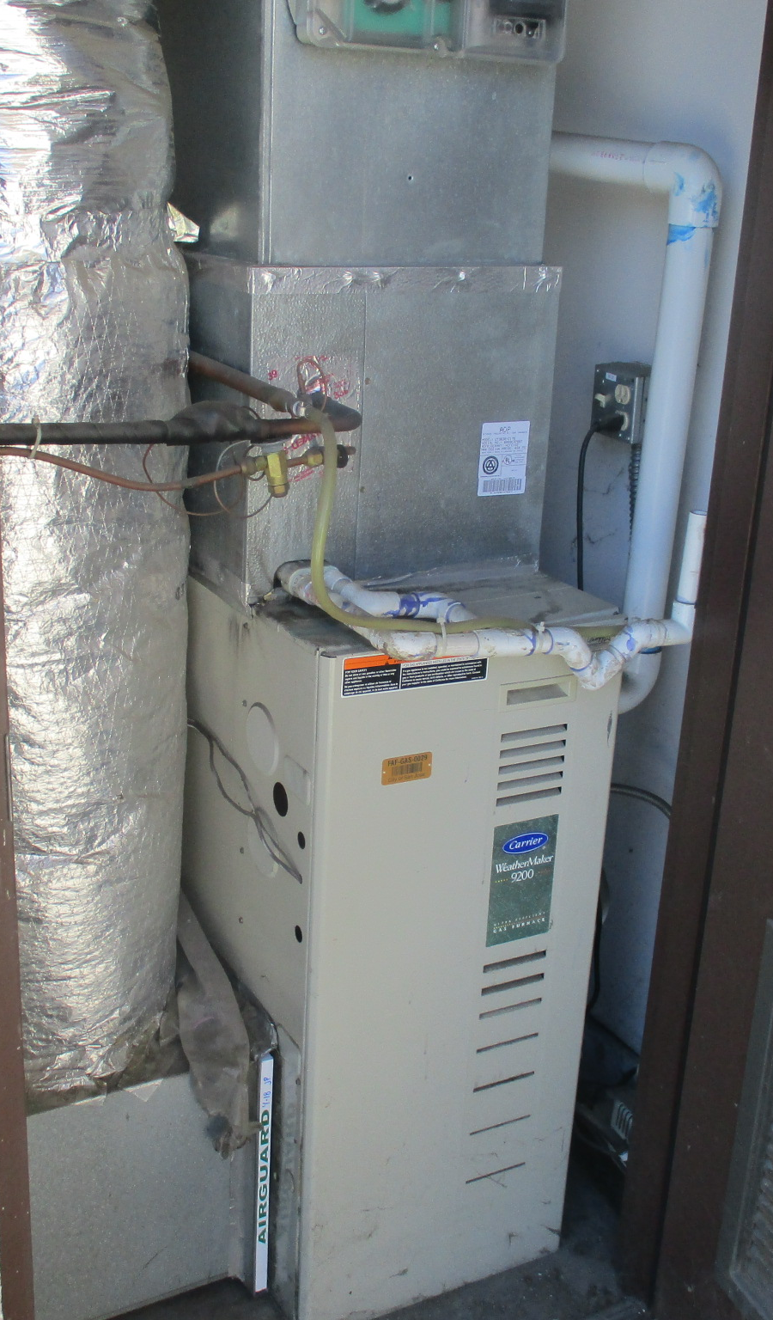
Basic Furnace Components
Cabinet design
Fans
Heat exchanger
Combustion system
AC coils
Controls
Venting
Filters
Notes:
Cabinet designs vary, but the principles remain the same. A direct- or belt-drive fan is used to remove heat from the heat exchanger and deliver heat energy to the zone. In a duct furnace (without a fan), the airflow across the heat exchanger is provided by an externally installed fan or central air system.
Typical heat exchangers in units with efficiencies of 85% or less are not intended for condensation. High-efficiency furnaces (efficiencies 90% or greater) will have stainless steel heat exchangers, which will condense water from the combustion gases.
The combustion system may have single or multiple ports.
Controls include an ignition device, fuel valve, fan switch, safety controls and thermostat.
Venting is either atmospheric or power vent. Venting on high-efficiency units uses plastic pipe.
Air filters are the simplest and most important component of the furnace, but often the most neglected.

Slide 15
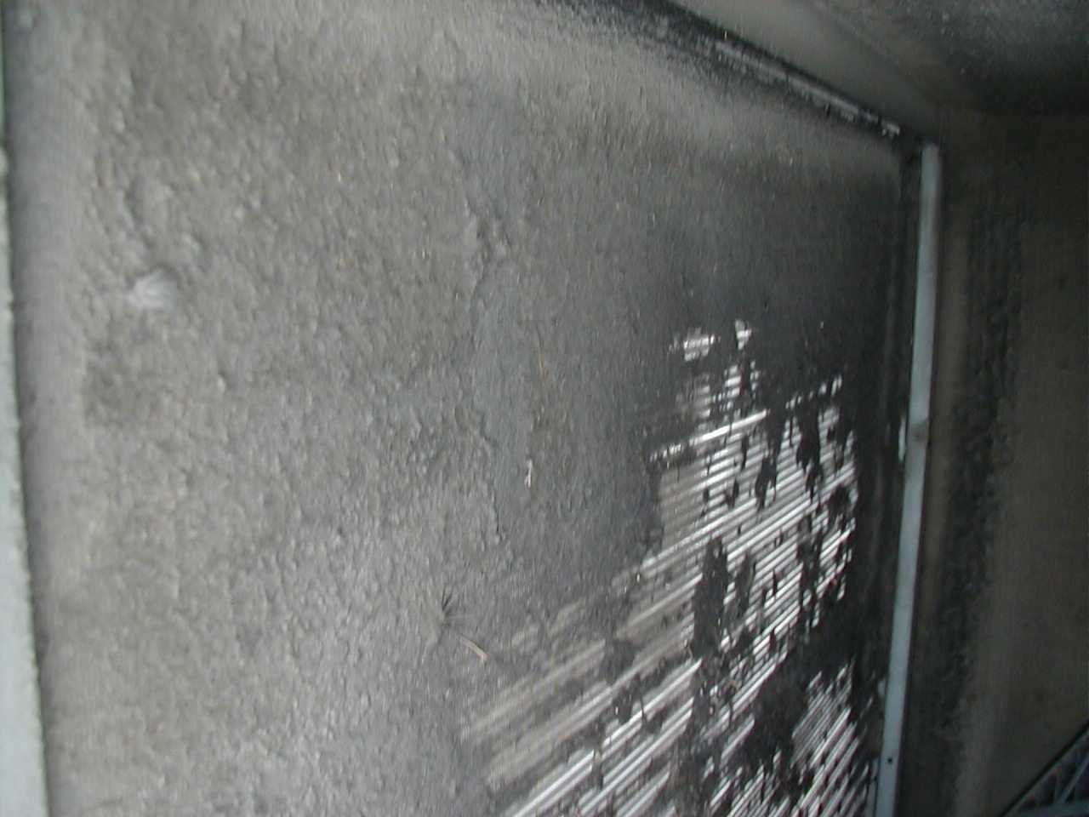
Furnace Maintenance
Air filters
Burner adjustments
Fan motor lubrication
V-belts adjustment
Clean furnace cabinet
Clean burners and heat exchanger
How many firing rates?
Notes:
• Check operating and safety controls.
• Keep air filters clean to give the proper air flow across the furnace and ensure efficiency of the unit.
• Make burner adjustments for proper fuel-to-air ratios. Check flame condition daily.
• Clean burners and heat exchanger
• Lubricate fan motors according to the manufacturer’s recommendations.
• Inspect v-belts at least quarterly for proper tension and excessive wear.
• Check all controls for fail mode. Make sure all components in the system are working.
• Routinely clean furnace cabinet.
(Refer to ASHRAE Standard 180 for more information.)

Slide 16
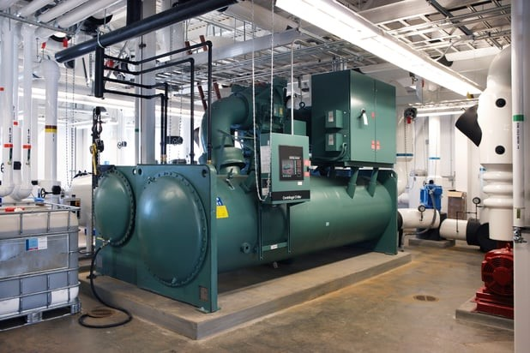
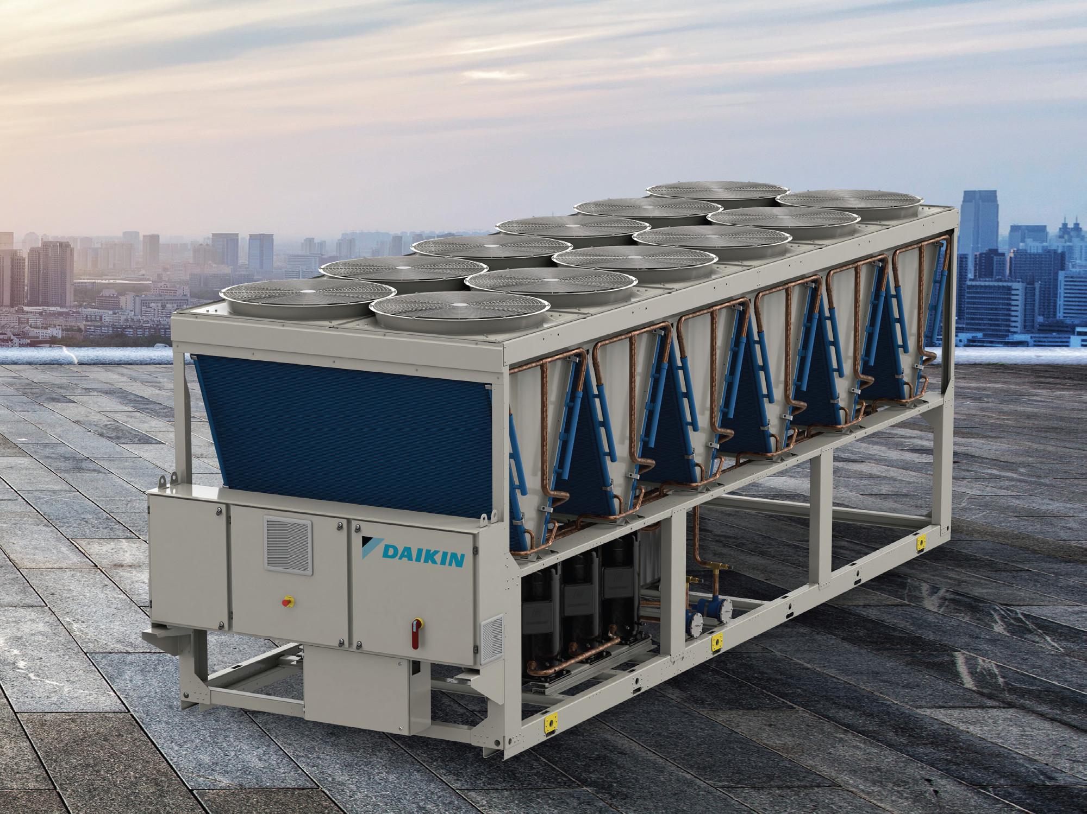
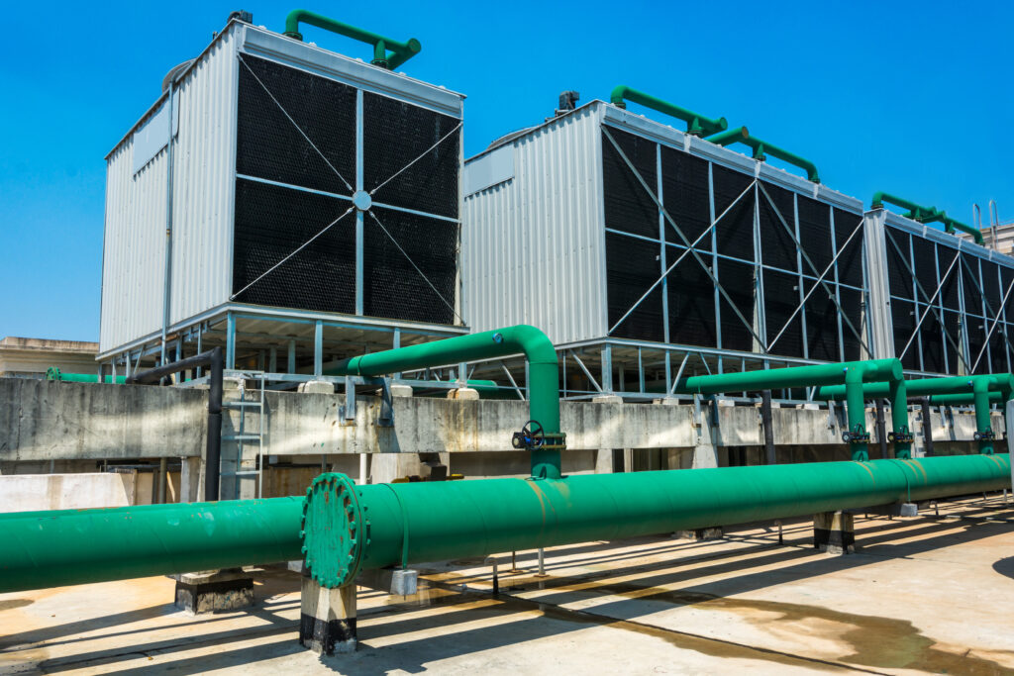
Chillers & Cooling Towers
Water-cooled chiller
Air-cooled chiller
Cooling Tower
Notes:
Chillers are found at larger commercial and institutional buildings where there are substantial cooling loads. Chillers utilize the refrigeration cycle to produce chilled water. Pumps distribute the chilled water from these units to remote zone locations.
Chillers utilize either air or water to remove heat from the cooling system. Cooling towers are used to reject heat from water-cooled chiller systems.
Image sources (clockwise from top left):
https://www.veris.com/blog/hvac-series-part-ii-chillers
https://commercial.daikin.com.au/articles/daikin-third-gen-r32-air-cooled-chiller
https://complete-es.net/blog/air-cooled-vs-water-cooled-chiller-cooling-towers-pros-cons/

Slide 17
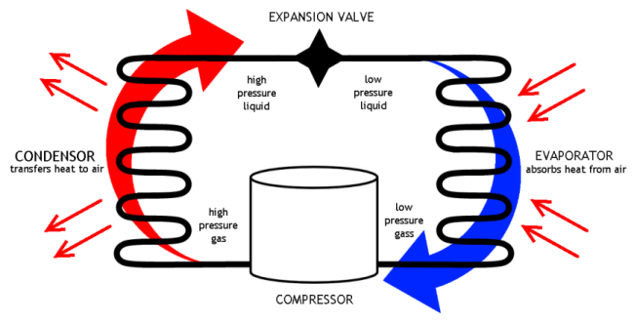
Refrigeration Cycle Terms & Definitions
Major components include:
1. Compressor – pumps gas – INCREASES PRESSURE
2. Condenser – rejects heat
3. Evaporator– absorbs heat
4. Expansion valve – meters refrigerant – DECREASES PRESSURE
CONDENSER
Transfers heat to air
EVAPORATOR
Absorbs heat from air
Notes:
Before we discuss cooling systems in more detail, let’s learn about the refrigeration cycle, which is the process that chillers use to create chilled water. This process is also used by other types of conditioning equipment such as heat pumps and refrigerators.
The vapor-compression refrigeration system uses a circulating refrigerant as the medium which absorbs and removes heat from the space to be cooled and rejects that heat elsewhere.
As the refrigerant moves through these components, it changes state from a liquid to a vapor and back again releasing or absorbing the “latent heat of vaporization.” Latent heat of vaporization (Btu/lb) is the quantity of heat necessary to change one pound of liquid to vapor without a change in temperature.
When a vapor condenses back into a liquid, the same quantity of latent heat is released to the surroundings. The figure above depicts a typical, single-stage vapor-compression system.
CONDENSER
Transfers heat to air
EVAPORATOR
Absorbs heat from air

Slide 18
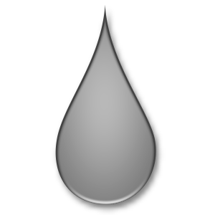
Refrigeration Cycle
Evaporator
Compressor
Cool Air to Space
System
Fan
Condenser
Fan
Condenser
Hot Air to Outside
Thermostatic Expansion Valve
Notes:
The refrigerant enters the compressor as a saturated vapor and is compressed to a higher pressure and temperature. The hot vapor is routed to the condenser where it is cooled and condensed into a liquid. As the refrigerant condenses from a vapor into a liquid, it is releasing the latent heat of vaporization. This is where the circulating refrigerant rejects heat from the system and the rejected heat is carried away.
The condensed liquid refrigerant is then routed through an expansion valve where it undergoes a rapid reduction in pressure. That pressure reduction results in the flash evaporation of a part of the liquid refrigerant.
The cold liquid and vapor mixture is then passed through the evaporator coil. A fan circulates the warm air across the coil. That warm air evaporates the liquid part of the cold refrigerant mixture.

Slide 19
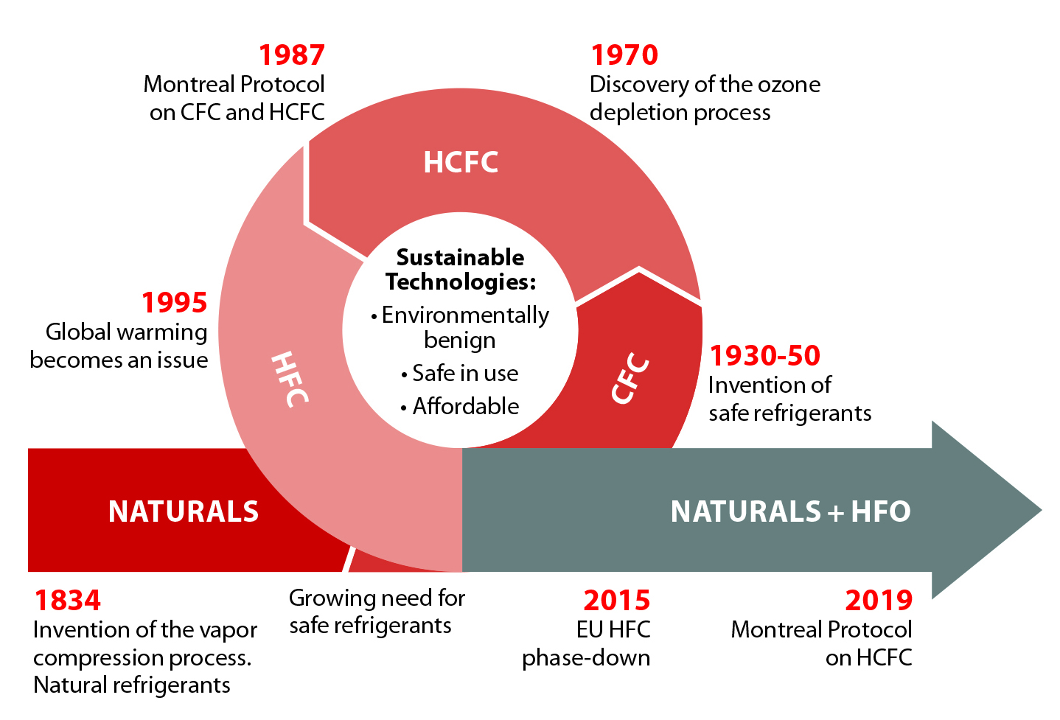
History and Evolution of Refrigerants
Refrigerants: CFC, HCFC, HFC, HC, HFO, Ammonia
Notes:
Refrigerants can have a substantial impact on the environment. Refrigerant leaks are a substantial contributor to the concentration of greenhouse gases in the atmosphere. Let’s discuss the history and evolution of refrigerants.
The chlorine in the refrigerant classes CFCs (chlorofluorocarbons) and HCFCs (hydro-chlorofluorocarbons) damages the ozone layer. The Montreal Protocol of 1987, an agreement signed by 180 nations, targets CFCs and HCFCs as ozone depleting substances, and requires that CFCs and HCFCs be phased out over a 40-year period that began in 1995. In response, a new family of refrigerants was developed. HFCs (hydrofluorocarbons, including HFC-134a, HFC-407C and HFC-410A) are ozone-friendly. So why doesn’t the new refrigerant family solve the problem? The reason is that HFCs have been found to have a very high Global Warming Potential (GWP), which is a scale that compares the global warming effects of different gases, using CO₂ as a reference. CO₂ (which when used as a refrigerant is referred to as R-744) has a GWP of 1, while some HFCs have a GWP of 1400 or more.
Hydrofluoroolefin (HFO) and Hydrocarbon (HC) refrigerants are 1234yf, and 1234ze, often referred to as fourth-generation refrigerants for the 21st century following chlorofluorocarbons (CFCs), hydrochlorofluorocarbons (HCFCs), and hydrofluorocarbons (HFCs). These classes of refrigerants have a much lower GWP than many HFCs. Research and development of refrigeration technologies is increasingly focused on low-GWP refrigerants, including “natural refrigerants” such as ammonia, carbon dioxide, hydrocarbons, air, and water. Ammonia is an industrial refrigerant with 0 GWP, and is often used for medium and low temperature food processing and storage facilities.
On January 1, 2030, a ban on remaining production and import of all HCFCs will take effect. The refrigerant phase out requires owners and administrators to take the long view when making decisions. In addition to the logistical standpoint of future availability of the type of refrigerants used in equipment, it is important to consider the climate impacts that refrigerant choices can have as well. Refrigerant leaks do happen, and GWP can be a significant determiner of the resulting impact. Refrigerants are often invisible and odorless, so they can be hard to detect. For any refrigerant-based equipment, preventive maintenance should include regular inspection using a refrigerant leak detector tool, and immediate repair of any leaks.
Sources: https://www.epa.gov/sites/default/files/2019-12/documents/fact_sheet_0.pdf
https://www.epa.gov/sites/default/files/documents/ASHRAE_PD_Natural_Refrigerants_2011.pdf
Image source: https://coolingbestpractices.com/technology/refrigeration-compressors/state-refrigerants-commercial-chillers

Slide 20
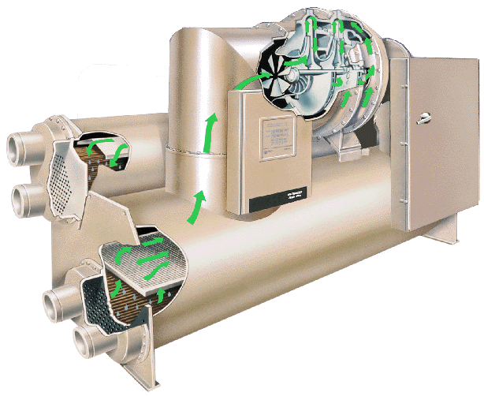
Chilled Water System Basics
Components:
Compressors
Evaporators
Condensers
Controls
Chilled water distribution
Temperatures: 42º to 52ºF
compressor
condenser
control panel
evaporator
Source: TRANE
Notes:
Now that we have an understanding of how the refrigeration cycle works, let’s discuss the various components of chilled water systems in greater detail.
• Compressor: Available types include centrifugal, reciprocal or rotary screw. Centrifugal compressors are still very popular but are increasingly being updated with the screw packages. Reciprocal, rotary screw, and scroll-type compressors are positive displacement machines.
• Evaporator: Typically utilizes a shell and tube heat exchanger to develop chilled water.
• Condenser: Large systems are water cooled with shell and tube heat exchangers and cooling towers. Smaller systems can be air cooled.
• Controls: Usually include a complex control package from the manufacturer, but are often connected to BAS (Building Automation System) for integrated control.
• Chilled water distribution: Typically utilizes a piping system similar to hydronic heating. Water treatment is necessary for chilled water and condenser water.
• Temperatures: Chilled water output temperature range from 42º to 52º F.

Slide 21
Water Cooled Chiller System
cooling
tower
heat rejection
loop
condenser
refrigerant
loop
expansion
valve
evaporator
compressor
chilled
water loop
facility cooling
load
Notes:
This is a simplified chilled water system layout. The primary components are the: Compressor, Evaporator, Condenser and Cooling tower. Some chillers do not use cooling towers to reject heat but instead use cooling water directly, dumping it to a drain, or some use fans to blow air directly across the condenser coil.

Slide 22
Water-Side Economizer
cooling
tower
heat rejection
loop
condenser
refrigerant
loop
heat
exchanger
evaporator
compressor
chilled
water loop
Isolate & bypass
Chiller equipment
facility cooling
load
Notes:
If the cooling tower alone can meet the required temperatures to provide chilled water, the mechanical chiller unit can be bypassed completely, saving the power costs of operating the electric powered chiller.
In this diagram, an open loop tower is shown that requires a heat exchanger to isolate the relatively fouled cooling tower water from the building loop and control valves.
In systems with closed loop evaporative cooling towers, the additional heat exchanger is not required to provide a water-side economizer.

Slide 23
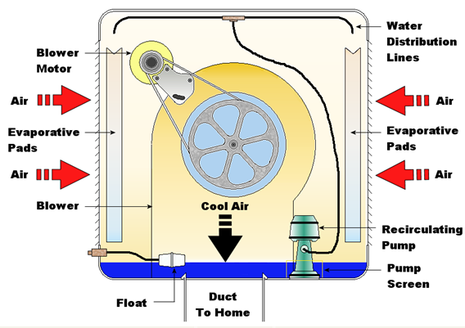
Evaporative Cooling
Climate-dependent
Use direct evaporation or indirect evaporation to cool
Maintenance considerations
Notes:
Evaporative cooling systems do not use mechanical refrigeration to provide cooling energy. Instead, they use water to lower the temperature of air supplied to the building for cooling purposes. Evaporative systems are commonly used in hot, dry climates when large amounts of outside air are required for ventilation purposes. They can reduce energy costs significantly.

Slide 24
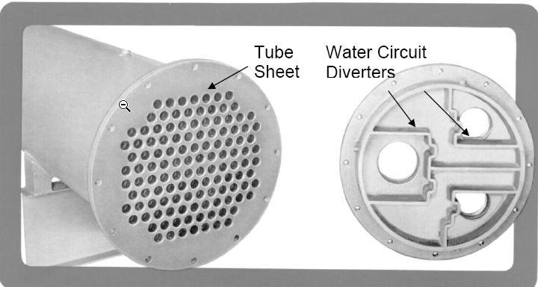
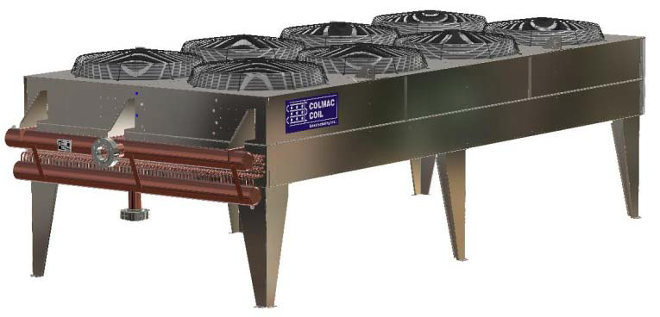
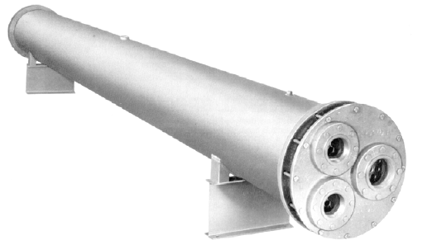
Condenser Illustrations
Air-cooled Condenser
Courtesy of Colmac Coil Corp.
Water-cooled Condenser
Courtesy of Refrigeration and Air Conditioning
Notes:
Air-cooled condensers are common in residential and commercial HVAC/R applications, but become less energy efficient as ambient temperature conditions rise, when compared to water cooled condensers.
Water-cooled condensers are typically more energy efficient than air-cooled condensers. The refrigerant condensing temperature in an air-cooled condenser is dependent on the ambient dry-bulb temperature.
ANSI/AHRI 460-2005: Performance Rating of Remote Mechanical-Draft, Air-Cooled Refrigerant Condensers

Slide 25
Air-Cooled Chilled
Water System
Example air-cooled chiller system
Notes:
In some cases, air may be used directly to remove heat from the chiller, eliminating the need for a cooling tower.
In an air-cooled chilled water system, the chiller’s refrigerant is cycled past air coils where it releases heat to the environment.
This type of system can be significantly less efficient than water-cooled systems, and can be economically justified only in areas where water is scarce or very expensive.

Slide 26
Air-Cooled Chilled
Water System, cont.
Example of air-cooled chilled water AC system
Notes:
This is another example of an air-cooled chiller system. Again, this diagram shows the air, water, and refrigerant loops, air handling units, the chiller and air coil, and typical temperatures.

Slide 27
Cooling Towers
heated air out
heated air out
drift
eliminators
external water
recirculation
condenser water in
warm
wet deck
(fill)
wet deck
closed circuit
to condenser
cool
air inlet
air inlet
cooled water out
spray pump
Direct-Contact Tower
Indirect-Contact Tower
Notes:
Cooling towers are used to reject heat on systems using water cooled condensers.
There are two types of cooling towers:
Direct-contact towers
Indirect-contact towers
Direct-contact (open loop) cooling towers typically have a high coefficient of performance (COP), which means they are very efficient. They operate with evaporation, fans and counter-draft, but require water treatment. Direct-contact evaporation cools water to wet bulb temperature.
Indirect-contact (closed loop) fluid coolers require a second coil. With indirect systems, none of the condenser water is evaporated. Indirect evaporative spray approaches the wet bulb temperature but doesn't quite reach it.
Dry fluid coolers require a second coil. A dry cooler uses air only over the condenser coil approaching only the dry bulb temperature, which is much less efficient than evaporative coolers that approach the wet bulb temperature. Without evaporation of any type however, they require less maintenance.

Slide 28
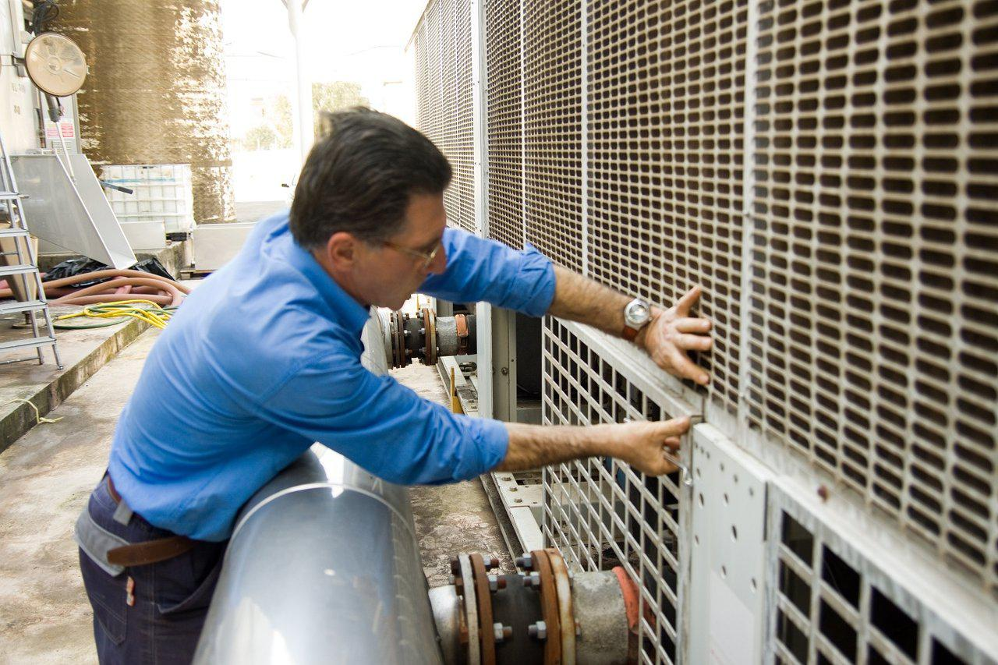
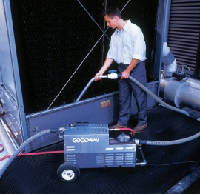
Cooling Tower Maintenance & Safety
Check air intakes and mist eliminators for blockage
Check spray heads for blockage
Clean sump of all biological organisms (legionella)
Clean mineral deposits
Maximize cycles of concentration
Service fan, including belts, bearings, housings
Check controls, calibrations
Notes:
A thorough, clear PM plan is needed for optimum cooling tower energy efficiency and service personnel safety.
Some important considerations:
Direct contact
Condenser water is exposed to contaminants from outside air, i.e., leaves, twigs, pigeons, etc.
Algae can slime the condenser tube bundles reducing flow and heat transfer capacity.
Sump and exposed water can freeze during cold weather operation.
Indirect contact
Algaecides are still needed for condenser tube bundles and spray water.
The use of anti-freeze makes cold weather operation and water-side economizer operation much safer.
Drain the water spray system and sump for cold weather operation.
For more information on cooling tower maintenance, visit this resource at the U.S. D.O.E. Federal Energy Management Program website: Best Management Practice #10: Cooling Tower Management | Department of Energy
Source: http://www.betterbricks.com/building-operations/cooling-towers

Slide 29
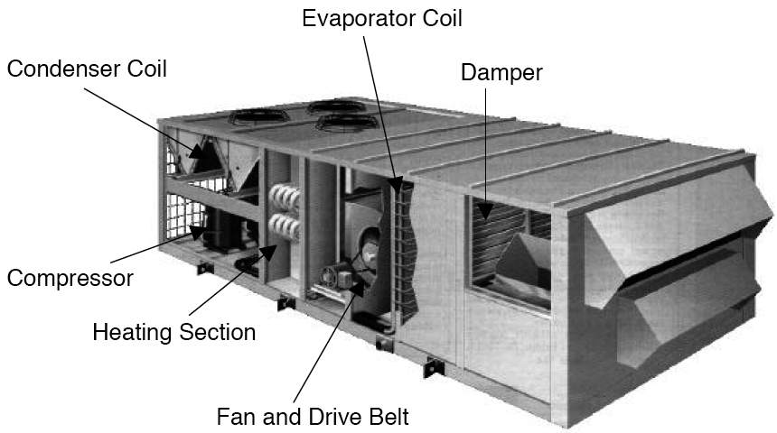
Packaged HVAC Systems
Notes:
Packaged HVAC systems are used in almost all classes of commercial buildings. 43% of all commercial buildings use packaged units for cooling, accounting for 58% of total commercial building floor space.
Packaged units are typically located on building rooftops or at ground level on concrete slabs. Because of their exposure to the elements, these units endure harsh conditions. Commonly, if no on-site staff are responsible for their operation, they get no attention until they break down.
¹ Source: Energy Information Administration, Commercial Buildings Energy Consumption Survey, 2018. https://www.eia.gov/consumption/commercial/data/2018/pdf/CBECS_2018_Building_Characteristics_Flipbook.pdf

Slide 30
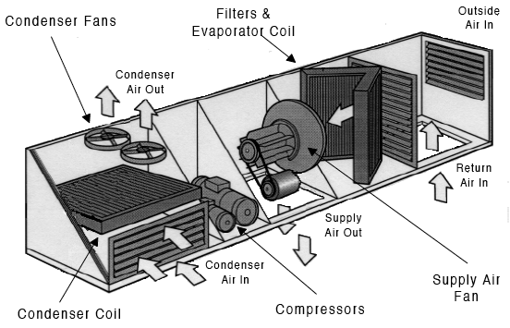
Components of a Packaged Unit
Source: Platts
Notes:
Key components of a packaged rooftop unit include:
Evaporator Coil: Also called the cooling coil, it contains liquid refrigerant. As warm air passes across the coil, it evaporates the refrigerant, which has cooling effect on the air.
Condenser Coil: a heat exchanger used to reject heat from hot, compressed refrigerant vapor. When heat is removed, the vapor condenses to liquid refrigerant.
Dampers: Used to control the volume of air flow. In packaged equipment with an economizer, dampers adjust the proportions of return air, exhaust air and outside air used for ventilation and “free cooling.”
Note: This diagram shows a packaged rooftop unit with cooling only. Many packaged rooftop units incorporate heating components as well.

Slide 31
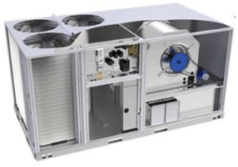
Heat Pumps
Move heat
Heating or cooling
Water, air, or ground source
Water or air load
Very efficient operation
Image credit: United Technologies Research
Notes:
Heat pumps are extremely energy efficient. Rather than creating heat, they move heat. They source heat from air, water, or the ground and transfer it to an air or water load. Heat pumps are based on the refrigeration cycle, but unlike air conditioners, they are capable of reverse operation to switch between heating and cooling by moving heat to or away from a space. Because heat pumps are all-electric, they avoid some of the negative environmental and health effects of fossil-fuel based equipment. They can be an effective way to meet decarbonization initiatives.
Heat pumps can work in all climates. They have many possible configurations and can thus be integrated with various other systems. They can work in the central plant, on a roof top, or next to a building. They are highly efficient, reliable and safe.
For more information on how a heat pump works, view the video at the link below:
https://www.youtube.com/watch?v=G53tTKoakcY (You can also access this video by searching “How A Heat Pump Works” on the Engineering Mindset YouTube channel.)

Slide 32
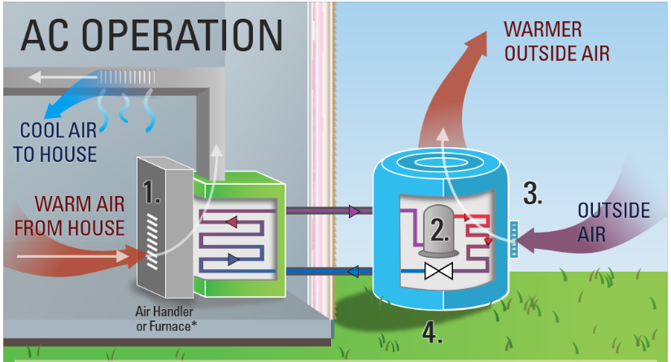
Heat Pump (Cooling)
Notes:
Warm air from inside the building is passed across a cool refrigerant coil, and the heat is absorbed by the liquid refrigerant, which evaporates into a low-temperature gas, and the cooled air is ducted back through the building.
The low-temperature gas refrigerant goes through a compressor, which raises its temperature and pressure.
Hot, high-pressure refrigerant gas is passed through the outdoor coil. The refrigerant passes heat to the outdoor air and condenses to a high temperature liquid.
Warm liquid refrigerant is passed through an expansion valve, which lowers pressure. As the pressure is reduced, the temperature of the liquid is reduced. The low-temperature, low-pressure liquid refrigerant is then piped back in the building.
*Ductless units operate similarly except they have no ductwork and blow cooled air directly into the room, typically via wall, ceiling, or console indoor units.
Note: The image above references a residential heat pump system, but the concept is the same for commercial systems.
Image source: https://www.energystar.gov/products/ask-the-experts/how-does-a-heat-pump-work

Slide 33
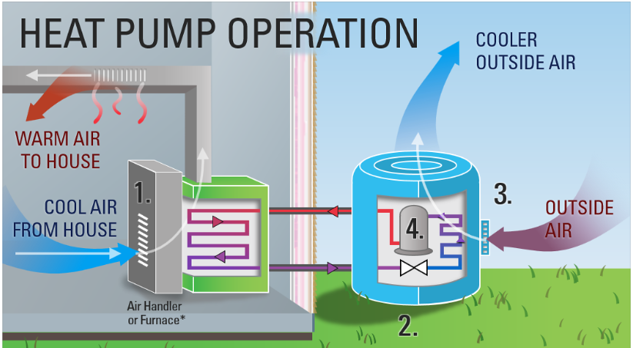
Heat Pump (Heating)
Notes:
Cold air from inside the building is passed across the high temperature, high pressure gas in the indoor coil, which transfers heat to the cold air. The refrigerant condenses to a liquid, and the warm air is circulated through the building.
Warm liquid refrigerant is passed through an expansion valve, which lowers pressure. As the pressure is reduced, the temperature of the liquid is reduced, and the cold refrigerant passes through the outdoor coil.
Heat energy transfers from the outside air to the low-pressure, low-temperature liquid refrigerant.
The low-temperature gas refrigerant goes through a compressor, which raises its temperature and pressure and passes it back to the indoor coil.
*Ductless units operate similarly except they have no ductwork and blow warmed air directly into the room, typically via wall, ceiling, or console indoor units.
Note: The image above references a residential heat pump system, but the concept is the same for commercial systems.
Image source: https://www.energystar.gov/products/ask-the-experts/how-does-a-heat-pump-work

Slide 34
Heat Pump Classification
Source
air, water, or ground
Distribution
ducted or ductless
Configuration
packaged or split

Slide 35
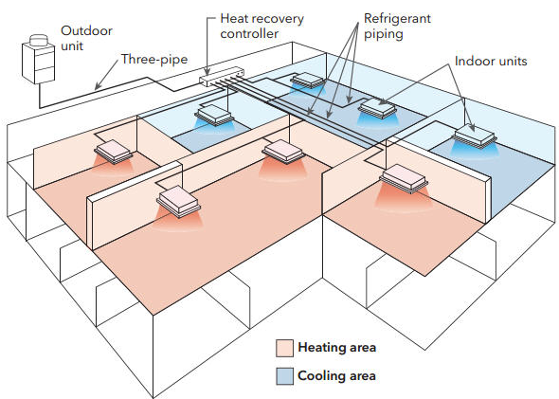
Variable Refrigerant Flow (VRF)
Very efficient
Multiple zones
Heating and cooling
All electric
Can provide DHW
Image courtesy of Slipstream Inc.
Notes:
Variable refrigerant flow (VRF) systems (also known as variable refrigerant volume or VRV) distribute heating and cooling throughout a building via refrigerant piping instead of ductwork. VRFs are very efficient and have many other benefits. One single outdoor unit can serve multiple zones with different heating and cooling loads in a building, and they can operate in a wider range of outdoor temperatures than traditional heat pumps, including very hot and cold climates. Compared to air-to-air heat pumps, VRFs offer better part-load efficiencies. They can also integrate heat recovery. They can be used to generate domestic hot water. VRFs are becoming more common in new construction as well as retrofit applications, for example to replace existing boilers and chillers.
Ductless mini-split systems are smaller VRF systems commonly used in light commercial and residential applications. They provide room solutions for isolated loads where a central system can not provide sufficient flexibility. However, they can be difficult to sub-meter to determine energy use from individual tenants.
Because VRF systems are typically all-electric, they can be a good choice for satisfying electrification initiatives.
Source:
https://facilityexecutive.com/2019/04/variable-refrigerant-flow-technology-commercial-facilities/

Slide 36
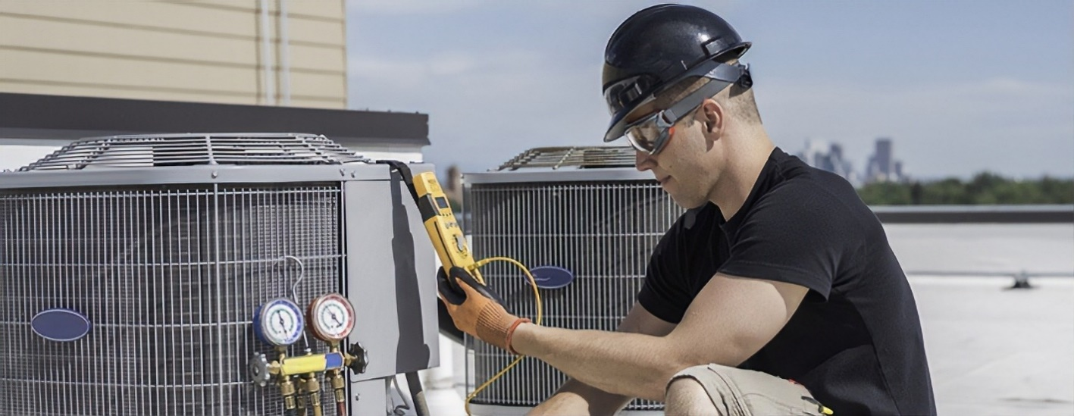
Maintaining and Optimizing Cooling Systems
General maintenance considerations
Refrigerant leaks
Condenser coils
Chiller maintenance
Cooling tower maintenance
Optimizing controls
Heat pump maintenance
Notes:
Here are some minimum general guidelines for maintaining and optimizing cooling systems:
General maintenance considerations: Keep filters clean, check oil heaters, follow manufacturer recommended inspections. Inspect electrical wiring and replace any damaged wiring or insulation. Clean and tighten connections as needed. Inspect and lubricate motors and bearings. While powered down, clean fans and check the blower wheel for balance. Inspect belts for tightness and wear. Remove vegetation and clutter from around outdoor units.
Refrigerant leaks: By law, must be fixed as soon as possible. Periodically measure and verify the refrigerant charge. Check for and repair any refrigerant leaks.
Condenser coils: Should be cleaned regularly and checked for debris that could block airflow.
Chiller maintenance: Check refrigerant quantity, system pressures and temperatures, water flow rates, and oil analysis. Calibrate controls. Clean water side of vessels.
Cooling tower maintenance: Check flows, water levels, clogged screens, sump, spray nozzles and water treatment. Check for corrosion and scaling. Also check pumps, fans, drives and freeze protection.
Optimizing controls: Check setpoint versus control point. Verify minimum condensing pressures are being implemented. Controls need to be checked regularly for accuracy, because they will drift out of calibration over time.
Heat pumps: Clean or replace filters and inspect/clean coils (indoor and outdoor) regularly. Clean supply intake and return vent screens. Inspect ducts and remedy any leaks, excess dust or debris. Flush and clean the condensate drain line and pan.

Slide 37
Discussion Question
In which piece of equipment would you find a condenser coil, evaporating coil, and compressor?
a. Chiller
b. Exhaust fan
c. Packaged HVAC system
d. Air-side economizer

Slide 38
Building Cooling Optimizing
Light-colored roof
Solar shading glass, film or blinds
Tight shell to reduce moisture load
VAV/Critical zoning during peak loads
Sensible energy recovery of exhaust
Internal equipment efficiency
Lights, motors, power supplies, copiers, printers
Process heat exhaust?
Notes:
Building optimization for cooling efficiency can be summarized as follows:
The Department of Energy (DOE) recommends light colored roofs because they reflect heat away from the building.
Keeping the heat of the sun out is very important.
Infiltration of humid air must be minimized, especially at entrances.
VAV can assist with load reduction if variable loads exist.
Sensible exhaust energy recovery can cut cooling loads by 50 percent.
The lower the internal electrical and process loads the less cooling needed.

Slide 39
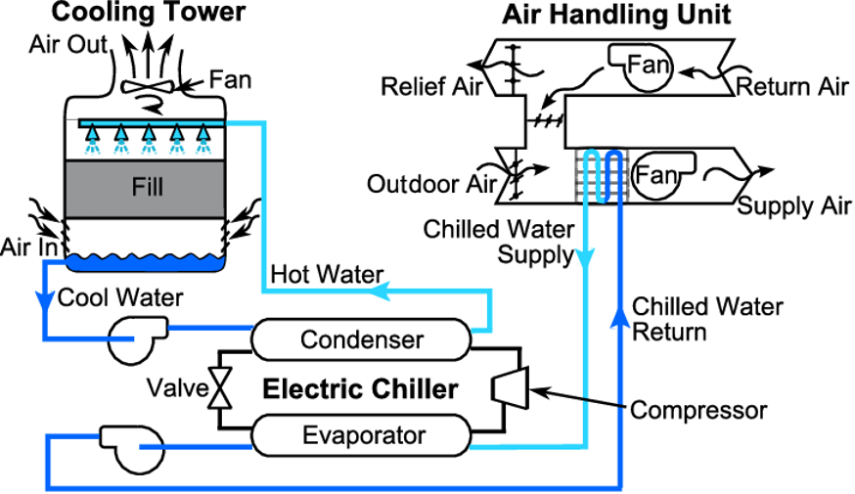
Activity – Walk Through the System
Notes:
Source:
https://www.researchgate.net/figure/Schematic-of-a-typical-chilled-water-system_fig1_261281692

Slide 40
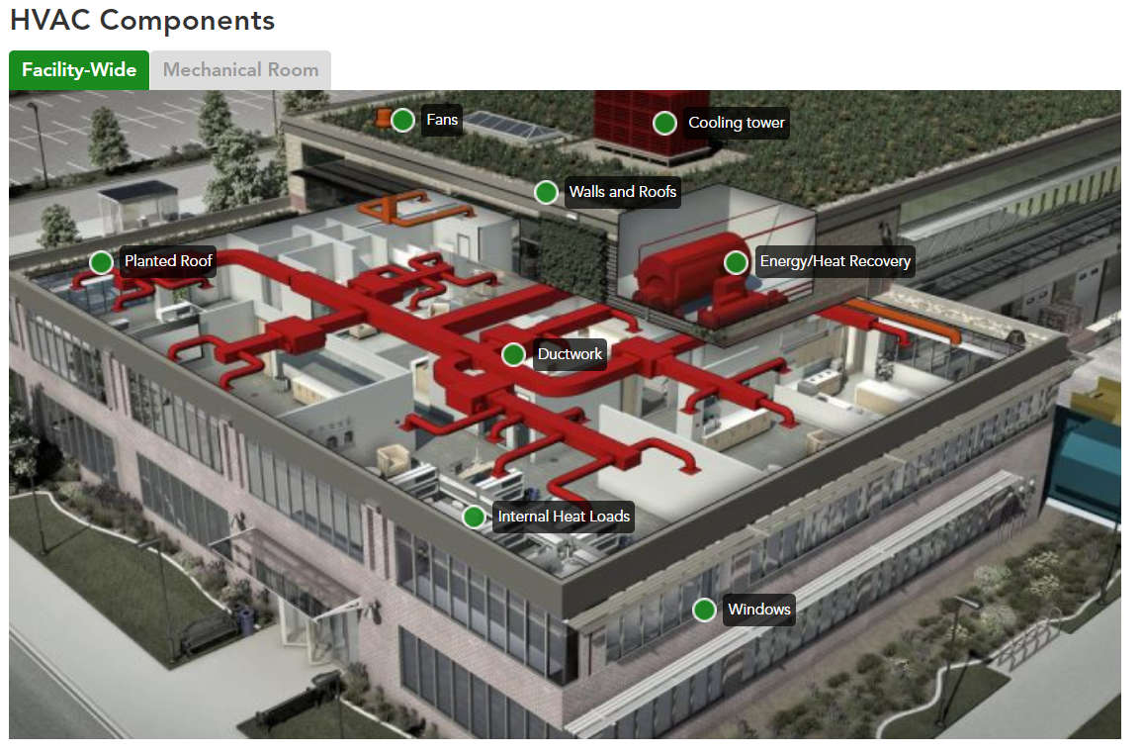
Facility HVAC Distribution Overview
https://sftool.gov

Slide 41
Hot Water Distribution Methods
Piping
2-pipe
4-pipe
Pumping
Water treatment
2-pipe system
4-pipe system
Notes:
A water distribution system with only one supply and one return pipe is called a 2-pipe system.
A building that has heating without cooling will have a 2-pipe system.
Many buildings with cooling will use a 4-pipe system which has separate supply and return pipes for heating and for cooling. The 4-pipe system allows both heating and cooling to occur in different areas, if needed. This is especially important during the spring or fall months.
Necessary water treatment is determined initially when the system is filled and should be monitored by in-house employees but under the guidance of a qualified water treatment sales engineer.

Slide 42
Air Systems: Basics
Return air (RA)
Outside air (OA)
Mixed air (MA)
Notes:
In air-to-air systems, the air hits the coil and begins the transfer process.
The temperature of the air is controlled at the air handler or reheated at the space.
The air distribution system contains all of the mechanical and serviceable components of the system including the outdoor air intake, filters, heating and cooling coils, and supply air fan. It also includes the interface to the controls to ensure appropriate heating or cooling of the air and maintenance of minimum ventilation rates when the building space is occupied.
After being conditioned to appropriate temperatures and/or humidity levels, the air leaves the air handler and enters the supply air path, where it is distributed to the various zones.

Slide 43
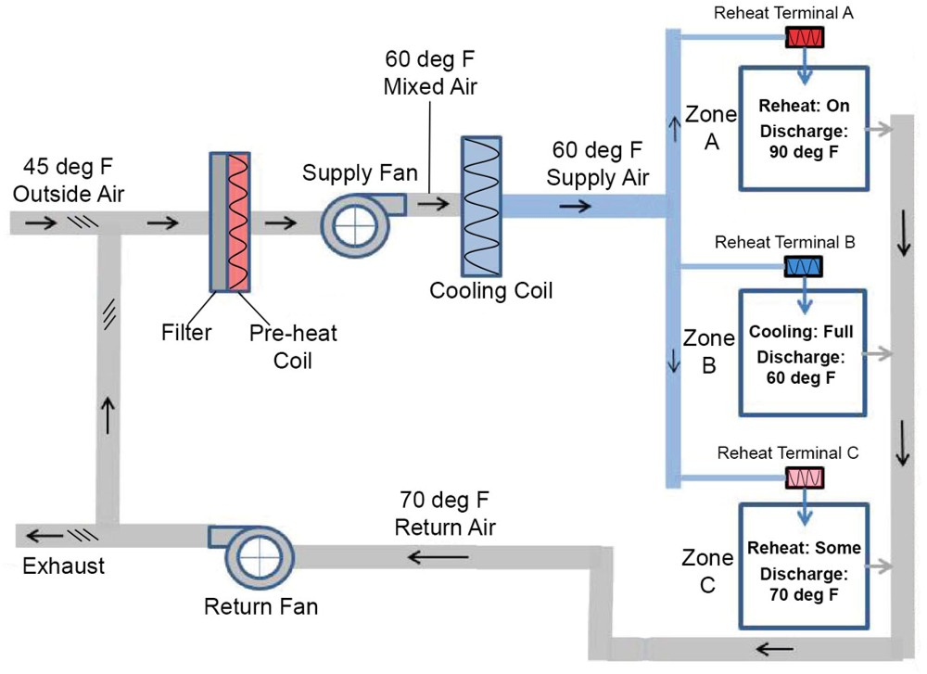
Constant Volume With Reheat
Central fan supplies constant amount of air
Reheat coil used to control discharge temp
CV fan systems with reheat are highly energy intensive
Image adapted from insulation.org
Notes:
Constant-volume (CV) systems are designed to provide a constant airflow and vary air temperature to meet heating and cooling loads. In a CV system, when the supply fan is on, a constant amount of air flows through; there is no modulation of the fan power, no discharge damper at the fan, and no damper at the terminal ends of the duct runs. In its simplest configuration, a CV system serves a single space (also called a zone).
Image adapted from insulation.org
Central fan supplies constant amount of air
Reheat coil used to control discharge temp
CV fan systems with reheat are highly energy intensive

Slide 44
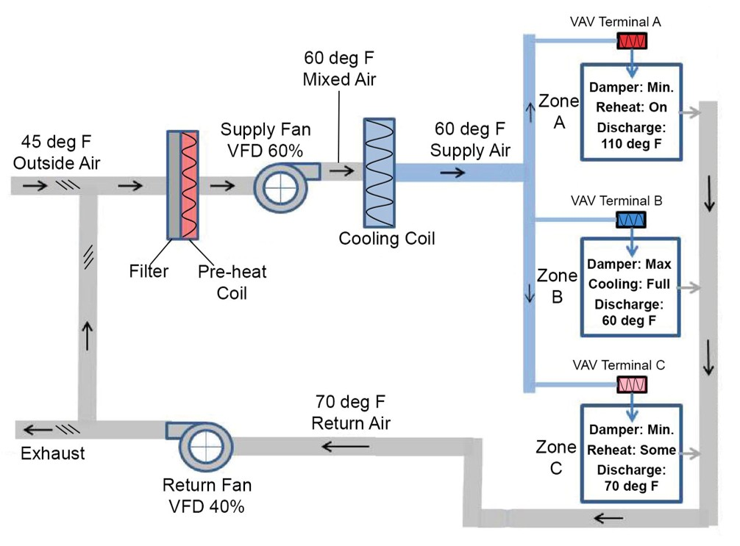
Variable Air Volume With Reheat
Central fan supplies cool air to VAV
VAV modulates flow as needed to cool space
When heating needed, VAV reduces flow to minimum & uses reheat coil to control discharge temp
Image adapted from insulation.org
Notes:
Currently available air distribution components, controls, and design strategies offer much more efficient designs than those installed and operating in many existing buildings. Today’s VAV systems can handle changing load requirements by varying the amount of heated or cooled air circulated to the conditioned space in response to varying heating or cooling loads. This reduces fan power requirements, which saves energy and costs.
VAV boxes work either by opening or closing dampers to vary the airflow through mixing boxes powered by VAV fans as loads in various zones of the building change.
If the box has reheat coils, the heating coil valve modulates as required to maintain heating set point and the preset minimum air flow, reducing simultaneous heating and cooling.
Image adapted from insulation.org
Central fan supplies cool air to VAV
VAV modulates flow as needed to cool space
When heating needed, VAV reduces flow to minimum & uses reheat coil to control discharge temp

Slide 45
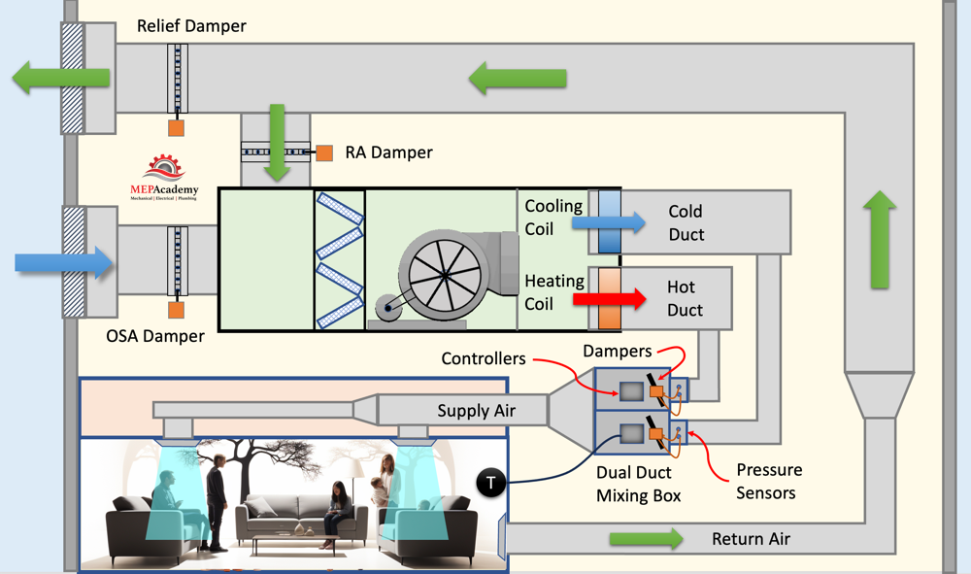
Dual Duct
Notes:
Often found in buildings constructed during the 1960s and 1970s, dual-duct systems are a relatively effective means of maintaining comfort, yet an extremely inefficient method of conditioning air.
In addition, the dampers in dual-duct mixing boxes frequently leak, even when they are supposed to be fully closed.
The mixing of the hot and cold air at the terminal box at each zone to maintain set point results in simultaneous heating and cooling. To help reduce the amount of simultaneous heating and cooling, the supply temperature of hot and cold ducts should be adjusted based on outdoor air temperature or actual load conditions to minimize energy wasted by mixing of the airstreams.
Image source: https://mepacademy.com/dual-duct-system/

Slide 46
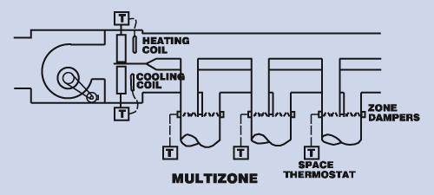
Multizone
Notes:
Multizone systems are similar to dual-duct systems in that two streams of air, hot and cold, are mixed to produce a desired temperature. But whereas dual-duct systems mix the air in individual boxes located at each area or room, multizone systems mix air with dampers near the fans. This conditioned air is then fed to each zone so that each zone receives air at a different temperature based on its load.
Advantages to the multizone design are:
require less ductwork and dampering
occupy less space
the location of the mixing dampers facilitates their inspection and repair
quieter
Disadvantages of multizone systems are:
wasted energy
significant pressure loss
the dampers on the hot and cold supply streams may leak
Image source:
https://energybooks.com/energy-efficiency-manual/table-of-contents/air-handling-systems/4-6-multizone-systems/

Slide 47
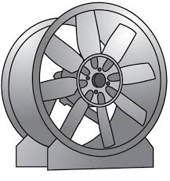
Air System Fans
Types:
Centrifugal
Axial
System Pressures:
Static
Velocity
Total
Controls:
On/off
VAV
VFD
VSD
Maintenance:
Clean fan blades
Lubricate motor
Replace belts
Variable Loads: use VAV/VFD
Notes:
Fan types are either axial (propeller) or centrifugal (squirrel cage) and are classified according to their static pressure capacity and output velocity.
There are three pressures to consider in a ducted fan system:
Static pressure is the pressure applied to the walls of the duct.
Velocity pressure is the pressure of the air moving through the duct.
Total pressure is the sum of both the static and velocity pressures.
Fan controls can be “on/off,” variable pitch (VAV), frequency control (VFD), or variable speed (VSD).

Slide 48
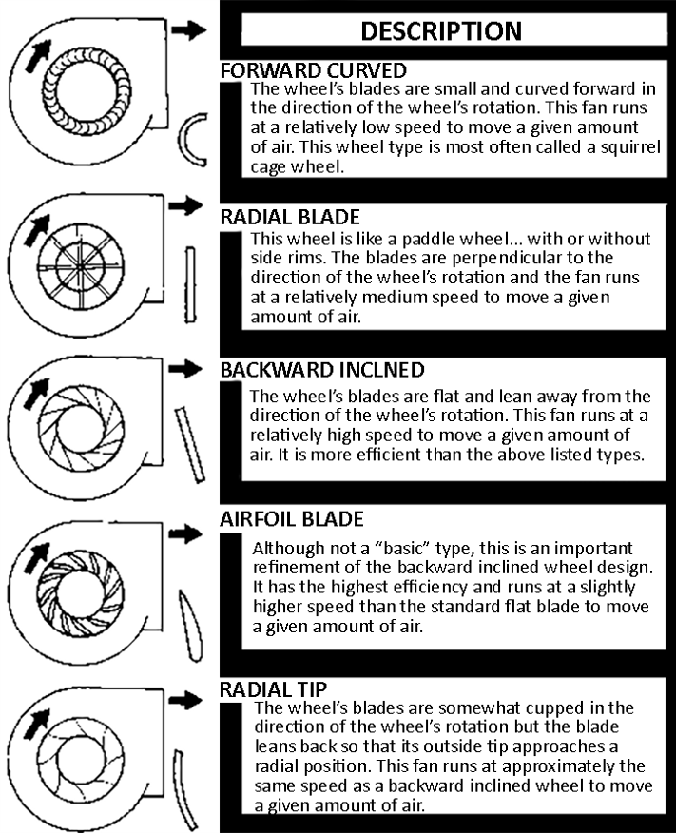
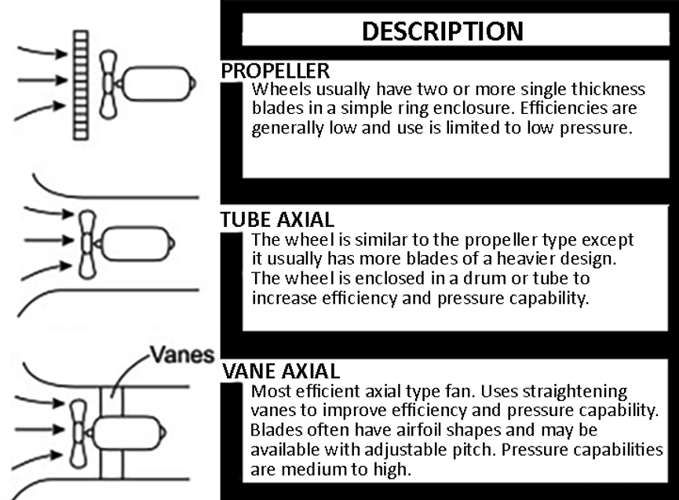
ASHRAE Fan Types
Centrifugal
Axial
Notes:
Centrifugal fans operate by drawing air in through the center of the fan wheel and discharging it in a direction that is 90° from the entry direction.
Axial fans draw and discharge air in the same direction as the axis of the fan (along the line of the shaft).
Note that an Inline Centrifugal fan is not an Axial Fan. Understanding the difference between centrifugal and axial fans is significant from a trouble shooting standpoint. Three phase motors can change their direction of rotation by accidentally swapping two phases. The effect of this change in rotation is different for axial and centrifugal fans. Flow direction stays the same in centrifugal fans although greatly reduced while in axial fans the flow direction reverses.

Slide 49
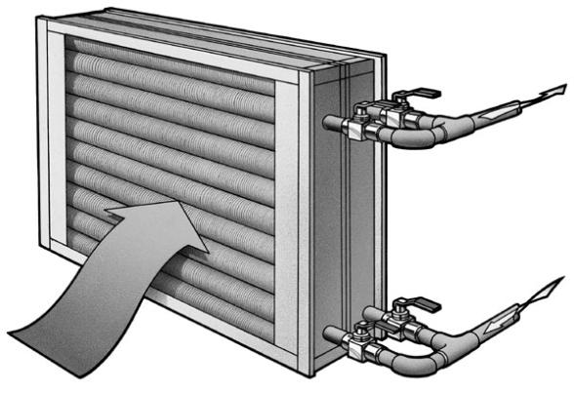
Coils
Types
Copper
Aluminum
Maintenance
Inspect/clean annually
Replace filters
Notes:
Heat exchangers (coils) are used in air systems to transfer heating and cooling energy to the air stream. Aluminum fins are used to increase the effective surface of the coil exposed for heat transfer. Coils are commonly constructed of copper or aluminum, or combination of both.

Slide 50
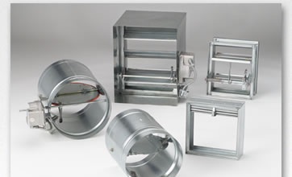
Dampers
Control dampers
Airflow dampers
Balancing dampers
Fire & smoke control
Courtesy: Ruskin
Notes:
Control dampers are typically either parallel or opposed.
Airflow dampers are used in duct systems to improve the flow of air and direct the air to go where wanted.
Balancing dampers are normally located right before the final delivery device and are used to adjust each zone for the proper air flow.
Fire dampers and combination smoke/fire dampers are used to prevent the spread of fire and smoke through the duct system. Fire dampers are actuated by a fusible link that melts and closes the dampers when temperatures in the duct system reach approximately 160 °F. Smoke dampers are connected to fire alarm/smoke control system and are actuated when the fire alarm is activated or smoke is detected in the air system.

Slide 51
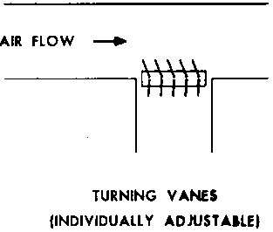
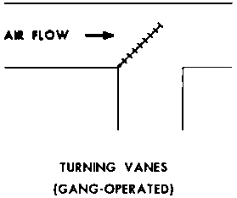
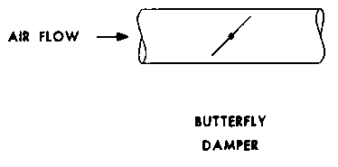
Damper Maintenance
Air leakage
Damper seals
Adjustments
Preventive maintenance
Notes:
Damper maintenance requires cleaning, checking seals and adjusting linkage when units are off.
Mechanical linkages change over time. It is important to check linkage for binding and control points.
Fusible links on fire and combination smoke/fire dampers should be checked periodically since the links will fatigue and fail over time.

Slide 52
Common Failure Modes for HVAC Equipment
Source: New Buildings Institute - PIER
Notes:
A New Buildings Institute PIER project identified a number of problems with HVAC systems as they are installed and operated in the field. Problems identified include broken economizers, improper refrigerant charge, fans running during unoccupied periods, fans that cycle on and off with a call for heating and cooling rather than providing continuous ventilation air, low airflow, inadequate ventilation air, and simultaneous heating and cooling.
Source: https://newbuildings.org/

Slide 53

Learning Activity #2
Mechanical Room Components
Turn to the Appendix of your handbook
Notes:
Please turn to the Appendix of your handbook to complete Activity 2.

Slide 54


Ventilation
Exhaust of
polluted air
Fresh air
supply
Notes:
In addition to providing heating and cooling, an important role of HVAC systems is to provide ventilation of adequate fresh air to keep occupants healthy and comfortable. The diagram on the left shows a simplified example of an HVAC system bringing in fresh air and exhausting polluted air via a system of ductwork. The image on the right shows more detail of some of the typical components of a ventilation system.
Image sources:
https://www.agoria.be/en/climate-neutral-building/building-technologies/technical-cards/ventilation-non-residential
https://www.engineeringintro.com/construction-works/ductwork-components-for-commercial-buildings/
Exhaust of
polluted air
Fresh air
supply
Ventilation

Slide 55
Discussion Question
What is the primary purpose of ventilation?
Supplying air to increase occupant satisfaction
Controlling air contaminant levels, humidity, or temperature
Providing heating and cooling to indoor spaces

Slide 56
Discussion Question
How much outside air is enough to meet our primary purpose?
Notes:
Next we’ll discuss outside air requirements in more detail.

Slide 57
Ventilation Requirements
ASHRAE Standard 62 (Standard for Acceptable Indoor Air Quality)
Agency Guidelines and Standards for CO₂
OSHA Industrial levels 5000 ppm
ASHRAE ventilation guidelines
Resulting CO₂ levels from dilution of exhaled breath depend upon the ventilation rate supply, including air leakage.
Notes:
ASHRAE Standard 62, Ventilation for Acceptable Indoor Air Quality, has been adopted by many states as the design standard for acceptable indoor air quality. For example, the required ventilation rate for office buildings is 17 cubic feet per minute (CFM) per person of outside air.
ASHRAE 62.1 varies the requirement for outdoor, clean air in different spaces by both the number of occupants present, the floor area in the space and the effectiveness of the ventilation system to provide acceptable IAQ.

Slide 58
Outside Air Usage: Minimum Requirements
ASHRAE Standard 62.1 - Ventilation Requirements
Education | CFM/ person | CFM/ sq. ft.
Art Rooms | 10 | .18
Auditoriums | 7.5 | .06
Classrooms | 10 | .12
Laboratories | 10 | .18
Libraries | 5 | .12
Lecture Rooms | 7.5 | .06
Music Rooms | 10 | .06
Media Centers | 10 | .12
Wood/Metal Shop | 10 | .18
Offices | CFM/ person | CFM/ sq. ft.
Conference Rooms | 7.5 | .06
Office Spaces | 10 | .12
Reception Areas | 10 | .18
Other | CFM/ person | CFM/ sq. ft.
Cafeterias/Dining | 7.5 | .18
Kitchens | 7.5 | .12
Shipping/Receiving | 10 | .12
Warehouses | 10 | .06
Notes:
Refer to your local mechanical code to determine minimum ventilation requirements for your space type and occupancy. Many jurisdictions follow the International Mechanical Code or ASHRAE Standard 62.1 requirements.
ASHRAE Standard 62.1 defines ventilation requirements for most commercial building space types. Minimum outside air requirements will vary based on:
Number of people in a space
Occupancy type (e.g. classrooms, laboratories, warehouses, etc.)
Total area & volume occupied.
A simple calculation for the outdoor airflow required for a single ventilation zone is:
(CFM/person) x (number of people in the space) + (CFM/sq. ft). x (total sq. ft.)
For example, a 600 sq. ft. classroom designed for 30 students would require:
10 CFM x 30 people + .12 CFM x 600 sq. ft. = 372 CFM
Systems that serve multiple ventilation zones require more complicated calculations and are usually based on meeting the requirements of the most critical zone.
Note: Ventilation for hospital facilities is defined in ANSI/ASHRAE/ASHE Standard 170: Ventilation of Health Care Facilities. This standard’s guidelines provide environmental control for comfort and odor, as these two things can be compromised without proper care and act as a hindrance to patient recovery.

Slide 59
Outside Air Percentage
How do you know if you are delivering enough fresh air?
Multiply this % by total volume of supply air
(return air) – (mixed air)
(return air) – (outside air)
% of outside air delivered =
x 100
Notes:
How do you know if your units are providing at least the minimum outside air required? Measuring is the only way to know for sure – Test and Air Balancing (TAB) should be performed periodically (ASHRAE 62.1 standard requires TAB every 5 years).
Elevated CO₂ is a predictor of poor air quality, but CO₂ measurements don’t contribute to meeting the ASHRAE standard.
Outside of your scheduled TAB assessments, you can measure outside air using temperature readings. To calculate the percent of outside air being provided to a space, use the formula shown above with temperature readings taken at the air handler level. Mixed air temperature should be measured after the filter bank, before the heating/cooling coils. Also, keep in mind that this is a point-in-time measurement to help understand what may typically be happening in your system. This process should be performed in heating season and in cooling season, on days representative of the hottest/coolest days typical of your climate, respectively. These readings should also be taken when the system is NOT economizing, since economizing will bring in more outside air than when solely in mechanical conditioning mode.
Supply air volume can be determined in a number of ways, for example by using an anemometer to take a duct traverse measurement, using a flow hood at a supply grill, or estimating the volume based on duct size and fan speed.
To determine if you are delivering enough fresh air to a space, multiply the percentage of outdoor air you are providing by the total volume of air, then compare that number to the amount required by the ventilation standard you are subject to. You can also use this method to identify areas where you may be over-ventilating and thus wasting energy.

Slide 60

Ventilation Standards
Notes:
This chart compares some different standards for ventilation in buildings.
Source:
https://sftool.gov/learn/about/626/enhancing-health-indoor-air#lever1

Slide 61
Common Issues
Common reasons minimum outside air requirements aren’t met:
Damper malfunction
Dirty filters
Excessive filtration (e.g. increased MERV rating on filters when system can’t handle it)

Slide 62
Group Discussion
What are some of the ways a damper can malfunction?
How can we minimize damper malfunctions?

Slide 63

Air System Terminals
Purpose:
Regulate airflow
Add reheat
Distribute air where needed
Types:
Single- and dual- duct VAV boxes
Reheat coils
Mixing boxes
Variable volume dampers
Maintenance – inspection and adjustment
Notes:
Air system terminals are used for any, or all, of the following purposes:
• Regulate air flow
• Add reheat
• Distribute air where it is needed.
Examples of air system terminals are variable air volume (VAV) terminal boxes, reheat coils, mixing boxes, and variable volume dampers.
Maintenance requires inspecting moving parts and adjusting to verify proper operation with the control system.

Slide 64


Ducting & Air Distribution
Pressures
Sealing
Insulation
Maintenance
Notes:
Ducting is used to transport heating or cooling energy to the individual spaces in the building.
Ducting should be sealed to limit air leakage. SMACNA (Sheet Metal & Air Conditioning Contractors National Association) has developed standards for construction and sealing of duct systems.
Ducting should be insulated (and weather tight if installed on the exterior) to prevent heat loss (and heat gain).
The primary maintenance issues with duct systems are sealing and insulation.
Flexible connections between equipment and ducting should be checked for leakage and repaired as required. Duct tape should not be used for sealing of ductwork.

Slide 65


Air Outlets and Inlets
Purpose: Balance air movement to control comfort
Characteristics:
Throw
Distribution patterns
Outlet velocity
Air-distributing ceilings
Inlets (return air)
Courtesy www.price-hvac.com
Notes:
The purpose of air outlets and inlets is to balance the air movement through the room to control comfort. If properly designed, the room will be laid out with the supply air opposite of the return (e.g., supply air comes into the room at a high level and return air is taken from a low level in the space).
Characteristics include the throw, distribution patterns, and outlet velocity. (See illustration of diffuser types.)
Inlets are the return air or sometimes called the cold air return.

Slide 66



Air Filters
Purpose: Keep particulates out of equipment; ensure good IAQ
Methods
Mechanical
Electronic/electrostatic precipitation
Air washes
Air filters
Fiberglass
HEPA
Bag
Electronic
Electrostatic
Bag
Fiberglass
Notes:
Methods to clean the air include electronic and electrostatic precipitation, mechanical filters, and air washes. Types available are:
• fiberglass
• HEPA
• bag
• electronic.
The primary function of the filter is to keep particulates out of the equipment. The filtration application can be changed or altered to include occupant concerns. While filtration is often viewed as helping to ensure good indoor air quality, poorly maintained or neglected filters can actually be a source of indoor air quality problems.

Slide 67

Filter Efficiency
A little bit about filters…

Slide 68
How Do we maintain these systems?

Slide 69
Elements of Effective O&M
Operations
Administration
Conduct of Operations
Equipment Status Control
Operator Knowledge and Performance
Administration
Work Control System
Conduct of Maintenance
Preventative Maintenance
Maintenance Procedures & Documentation
Maintenance
Engineering Support
Engineering Support Organization & Administration
Equipment Modifications
Equipment Performance Monitoring
Engineering Support Procedures & Documentation
Training
Administration
Administration
Employee Training
Training Facilities & Equipment
Operator Training
Maintenance Training
Organization and Administration
Management Objectives
Management Assessment
Industrial safety
Notes:
Five well-defined elements of an effective O&M program include those presented in the OMETA concept:
Operations
Maintenance
Engineering Support
Training
Administration
Source: https://www.pnnl.gov/projects/om-best-practices/ometa-integrated-approach-operations-maintenance-engineering-training-and-administration

Slide 70
“Operation” Tasks
Specific operating settings of equipment and controls
Room temperature setpoint
Supply air temperature setpoint
Equipment start/stop times
Ventilation and Economizer operation
Fan speed and CFM air delivery
Pump speed and GPM water circulation
Control valves and damper settings
Document sequence of operation & setpoints
Notes:
Operating settings of control systems and efficiency of equipment have a significant impact on the energy consumption of building systems.

Slide 71
“Maintenance” Tasks
Tasks required to maintain a piece of equipment in good operating condition
Change filters
Adjust belt tension
Lubricate bearings to OEM recommendations
Service equipment according to manufacturer schedule
Clean heat transfer coils
Water treatment
Where is your O&M Manual?
Notes:
Equipment manufacturers provide detailed instructions of the recommended daily, weekly, monthly, and annual maintenance tasks required to maintain a piece of equipment in good working condition.
These instructions are typically provided to the building owner in the form of an Operations and Maintenance Manual at the time of building construction.
Adhering to the recommended equipment maintenance schedules AND keeping the O&M Manual up to date as changes are made to the building is an important element of effective O&M plan implementation.

Slide 72
Value of O&M Best Practices
Reduce the cost of building ownership.
Maintain the value of building assets.
Maintain efficiency of equipment.
Improve productivity of O&M staff.
Improve coordination between staff.
Increase productivity of building occupants.
Maintain healthy indoor environments.
Avoid litigation caused by poor building performance.
Improve reliability of major equipment.
Support facility ‘sustainability” goals.
Notes:
In addition to energy/resource savings, a well-run O&M program will:
Increase the safety of all staff as properly maintained equipment is safer equipment
Ensure the comfort, health and safety of building occupants through properly functioning equipment providing a healthy indoor environment
Confirm the design life expectancy of the equipment is achieved
Facilitate the compliance with federal legislation such as the Clean Air Act and the Clean Water Act

Slide 73
Resources for O&M Best Practices
FEMP O&M Best Practices
PECI O&M Best Practices
ENERGY STAR Building Upgrade Manual
ASHRAE Standard 180
Notes:
Additional resource publications are handy to have on the bookshelf. These resources are excellent and available free online.
https://www.energy.gov/eere/femp/articles/operations-and-maintenance-best-practices-guide-achieving-operational-efficiency
https://www.energystar.gov/buildings/tools-and-resources/fifteen-om-best-practices
https://www.wbdg.org/FFC/EPA/ENERGYSTAR/EPA_BUM.pdf
https://www.ashrae.org/technical-resources/standards-and-guidelines/read-only-versions-of-ashrae-standards (Note: Downloadable versions of the ASHRAE standards must be purchased, but read-only versions are available for free at the link above. Scroll down to find Standard 180.)

Slide 74

Types of Maintenance
Reactive
Preventive
Predictive
Notes:
There are three types of maintenance approaches in facilities.
Reactive maintenance (also known as corrective) takes a “run ‘til it breaks” approach.
Preventive maintenance take a proactive approach.
Predictive maintenance takes a proactive approach and also involves the use of advanced diagnostic tools.
We will discuss each approach in the next few slides.

Slide 75

Reactive Maintenance
The “fire drill”
Advantage: Low cost and less staff (short term only)
Disadvantages:
Increased cost due to unplanned downtime of equipment.
Increased labor cost, especially if overtime is needed.
Cost involved with repair or replacement of equipment.
Possible secondary equipment or process damage from equipment failure.
Inefficient use of staff resources.
Image source: https://gentryac.com/
Notes:
Reactive (also known as “corrective”) maintenance is the world’s oldest approach to maintenance. Also called “run-to-failure,” reactive maintenance refers to maintenance tasks performed after an asset has broken down. The focus is on restoring assets to operating conditions as quickly as possible.
Reactive maintenance is basically the “run it till it breaks” maintenance mode. No
actions or efforts are taken to maintain the equipment as the designer originally
intended to ensure design life is reached.
SOURCES: https://thebossmagazine.com/maintenance-statistics/ https://www.plantengineering.com/articles/plant-engineering-2017-maintenance-study/

Slide 76

Preventive Maintenance
Advantages
Cost effective in many capital intensive processes.
Allows for the adjustment of maintenance schedule.
Increased component life cycle.
Reduced equipment or process failure.
Disadvantages
Catastrophic failures still likely to occur.
Labor intensive.
Includes performance of unneeded maintenance.
Energy savings.
Notes:
Preventive maintenance is a more proactive approach than reactive maintenance and can be defined as follows: Actions performed on a time- or machine-run-based schedule that detect, preclude, or mitigate degradation of a component or system with the aim of sustaining or extending its useful life through controlling degradation to an acceptable level.
The U.S. Navy pioneered preventive maintenance as a means to increase the reliability of their vessels. By simply expending the necessary resources to conduct maintenance activities intended by the equipment designer, equipment life is extended and its reliability is increased. In addition to an increase in reliability, dollars are saved over that of a program just using reactive maintenance. Studies indicate that this savings can amount to as much as 12 percent to 18 percent on average.
Source: https://www.energy.gov/sites/prod/files/2020/04/f74/omguide_complete_w-eo-disclaimer.pdf

Slide 77

Predictive Maintenance
Advantages
Increased component operational life/availability.
Allows for preemptive corrective actions.
Decrease in equipment or process downtime.
Decrease in costs for parts and labor.
Energy savings.
Disadvantages
Increased investment in diagnostic equipment and staff training.
Savings potential not readily seen by management.
Notes:
Predictive maintenance is used to predict equipment or component maintenance by monitoring and/or measuring corrosion, oil condition, arcing, bearing wear, overheating and other parameters that can lead to the breakdown of equipment. This differs from preventative maintenance, which is performed on a time-based schedule. Measurements are taken and diagnostics are performed using a number of predictive maintenance technologies including infrared thermography; lubricant and wear analysis; ultrasonic analysis; vibration analysis; motor analysis; and performance trending. The table below shows common predictive technology applications¹.
__________________ ¹ FEMP O&M Best Practices Guide 3.0, Chapter 6 Predictive Maintenance Technologies

Slide 78

O&M Practices
O&M measures should be considered prior to the installation of significant energy conservation measures. Why?
Low- or no-cost
Easily implemented by in-house personnel
Immediate payback
Less intensive than capital projects
Notes:
The FEMP Best Practices Guide advises that O&M measures should be considered prior to the installation of significant energy conservation measures. Taking proactive O&M measures can often be the most cost-effective way to help to optimize equipment performance for greatest efficiency and effectiveness. For example, performing operations tasks like optimizing equipment schedules to match actual occupancy and/or maintenance tasks like changing filters and repairing broken dampers can sometimes save significant amounts of energy. These kinds of tasks are often low or no cost, so they should be performed before investing in significant energy conservation measures like replacing equipment.
Do you agree? Why or why not?

Slide 79

Case Study O&M Best Practices
Kaiser Permanente, Portland, OR
Urgent care medical office building
51,000 square feet
Reduced occupant complaints by 23%
$33,000/year energy savings
Notes:
Kaiser Permanente chose a 30-year old Medical Office building located in Portland, Oregon for a pilot project to test the effectiveness of a targeted approach to identify the most cost-effective opportunities for building improvement. The strategy chosen involved two distinct areas of focus: building tune-up or re-tuning, and enhanced O&M. In the building tune-up, a systematic examination of the mechanical system was performed. In the process, several issues such as stuck dampers, disconnected reheat coils, and miscellaneous issues with VAV boxes were identified and fixed. Enhancing the O&M included implementing controls strategies such as weekend and holiday scheduling and optimizing use of outside air, as well as recalibrating critical control sensors.
Since the process was implemented, Kaiser Permanente has reduced its occupant complaints by nearly 23 percent. Now with a comfortable building, both staff and patients can relax and focus on the important work of getting well. The anticipated energy savings from the improvements is approximately $33,000 per year.
Source: BetterBricks Case Study https://betterbricks.com/uploads/resources/KaiserOpsCaseStudyFinal.pdf

Slide 80
What Did We Learn?
HVAC equipment basics
The role of ventilation
Benefits of preventive maintenance

